Slide 1
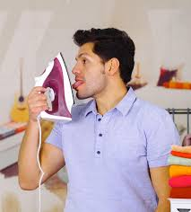
Irony
Boy, this iron sure tastes good!
“Feels and tastes just like iron!”

Slide 2
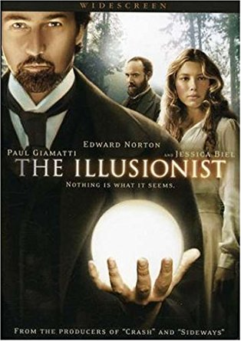
What is Irony?
Irony is the difference between what one would normally expect to
happen in a common situation and what actually happens.
Irony occurs when the usual expectation of a common situation
turns out differently

Slide 3
Types of Irony
There are 3 types of irony. They are…
1] Verbal Irony
“Slippers to a wedding? That’s a great idea, Patrick!”
2] Situational Irony
A fire hydrant on fire.
3] Dramatic Irony
“He thinks he’s kissing a woman!”

Slide 4
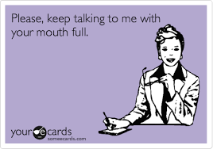
What is Verbal Irony?
Verbal Irony occurs when a speaker says one thing but
really means something else.
When spoken aloud, a person’s tone of voice helps to
identify it.
Click

Slide 5
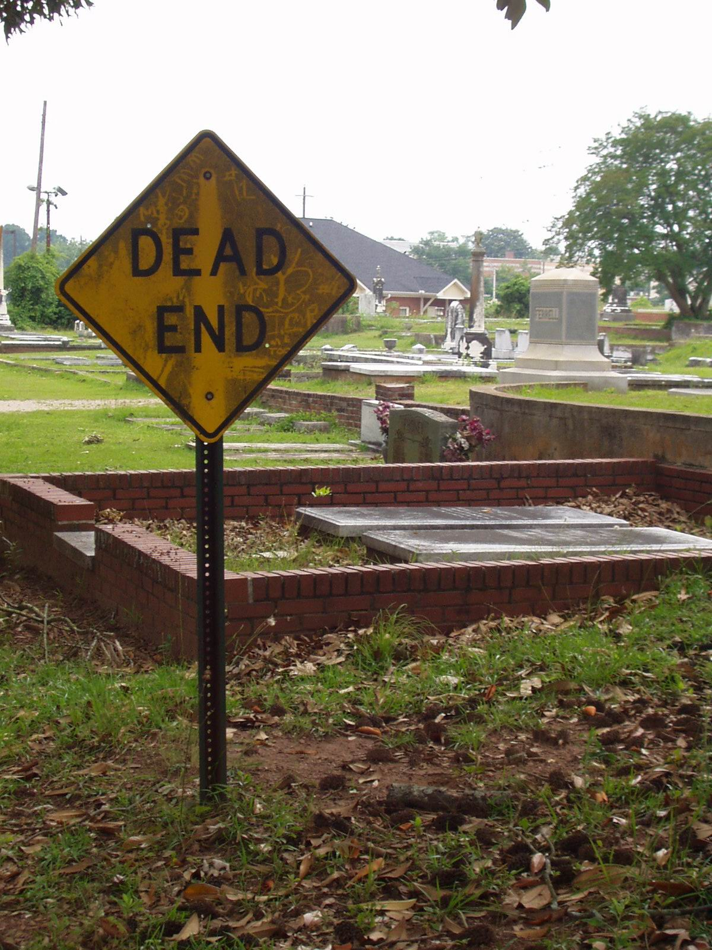
What is Situational Irony?
Situational irony occurs when a given situation
turns out to be different than what we would
normally expect in such a situation.
Writers often use this type of irony to create
surprise endings, a great plot twist.
Click

Slide 6
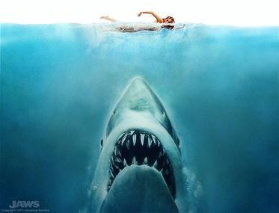
Dramatic Irony
Dramatic irony occurs when the audience knows
something critical or important to the story that a character (or characters) does not know.
We see this type of irony a lot in horror movies and
romantic comedies.
Click

